Slide 1
6372 Unit 12 Pre-Live Assignment
By-Rashmi Patel

Slide 2
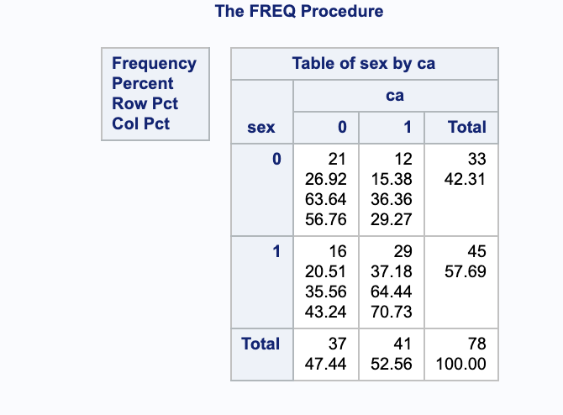
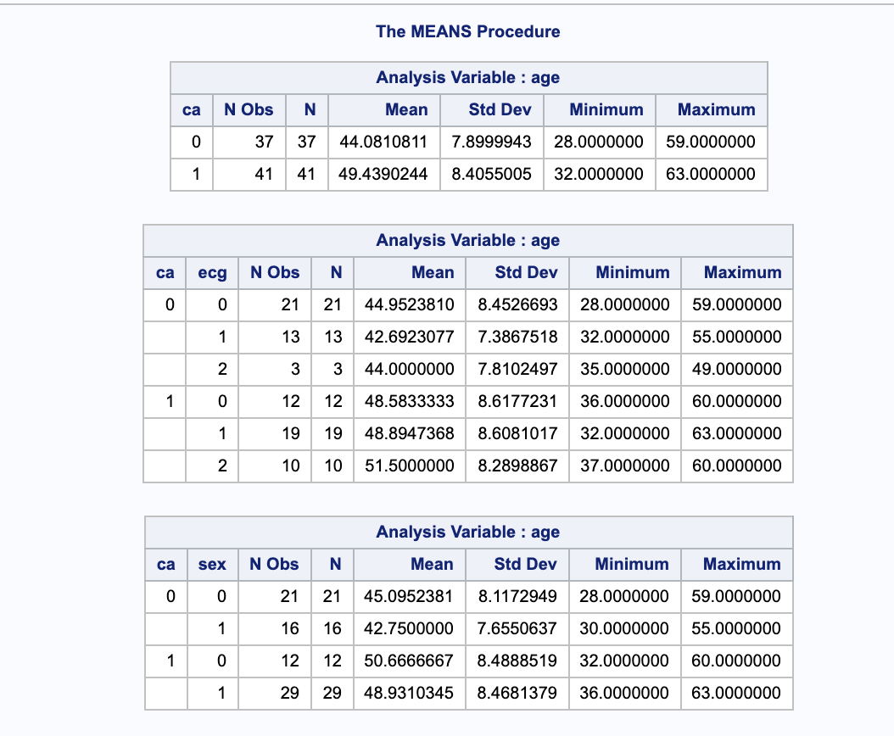
Proc Freq and Proc Means
(Proc Freq Procedure)
(Proc Means Procedure)
Based on the above tables. It seems like that there is at least one group that is different. The tables seem to indicate that males, in general have higher instances of the disease.
There are also more males in the sample, and those males have higher instances of the disease.
In proc mean, we can see that the various tests are all significant, thus indicating that one of the groups shows a difference (at least evidence of one.)

Slide 3
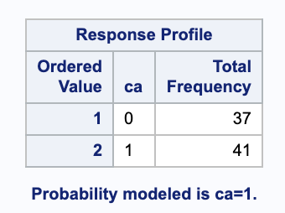
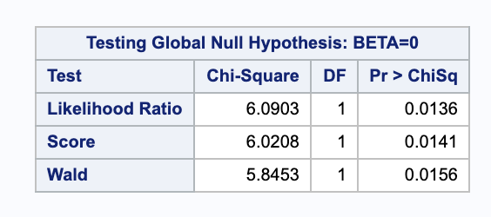
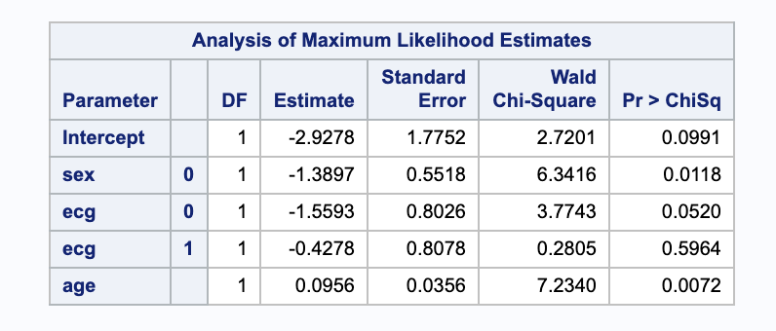
Logistic Regression with Three Predictors
(Response Profile, n =78)
(The chi-square test statistics and associated p-values shown in the table indicate that each of the three variables in the model significantly improve the model fit) Overall model is significant
The results in this table show coefficients and standard errors.
Sex and age are significant.

Slide 4
Provide an interpretation of the regression coefficient for Age. What does the value represent in terms of the odds of having the disease?
For every one-unit change in age, the log odds of coronary artery disease (vs no coronary disease)
increase by 0.0956.

Slide 5
What is the odds ratio of a person with an Age=55 having coronary artery disease with respect to someone with who is 45years of age given they are both males and have the same ECG result. (See 20.2.2 in text) Pay attention to the output you may need to do some “flipping” (reciprocal 1/OR).
Exp(0.0956*(45-55))=0.620, or about 2/3. A 55-year-old surviving has about 2/3 the odds of a 45-year-old

Slide 6
Consider a new patient comes into a doctors office and has measurement ECG=2, Age=50,Sex=Male. What is the probability that this person has the disease? (Here we are trying to predict if the new person has the disease or not.)
Logit(∏) = -2.9278-1.3897*(1)+0.0956*(50)-0.4278*(1)=0.0347

Slide 7
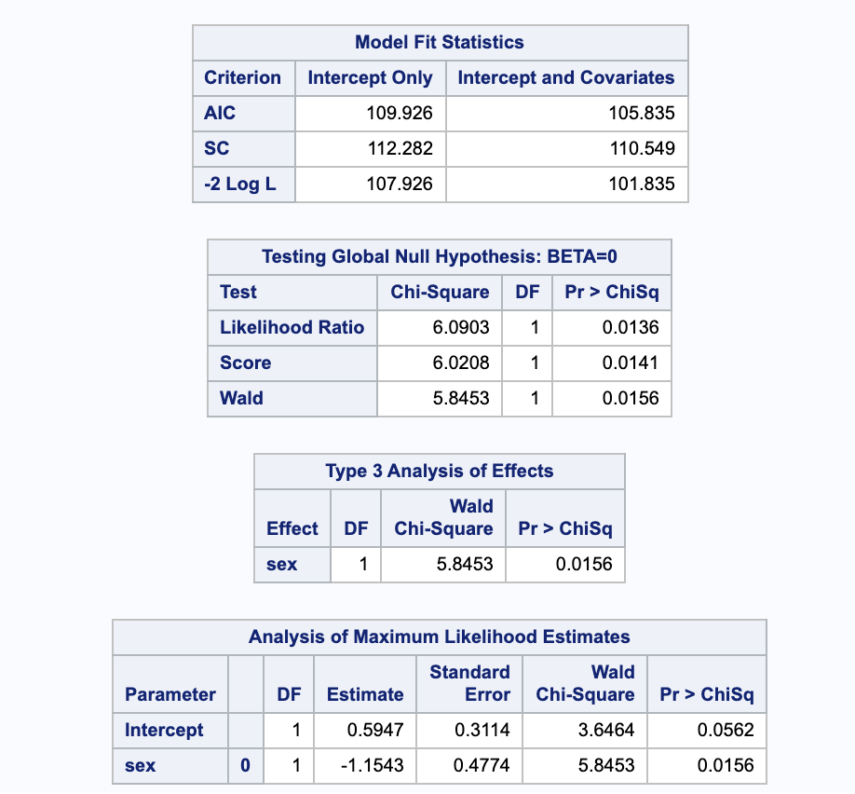
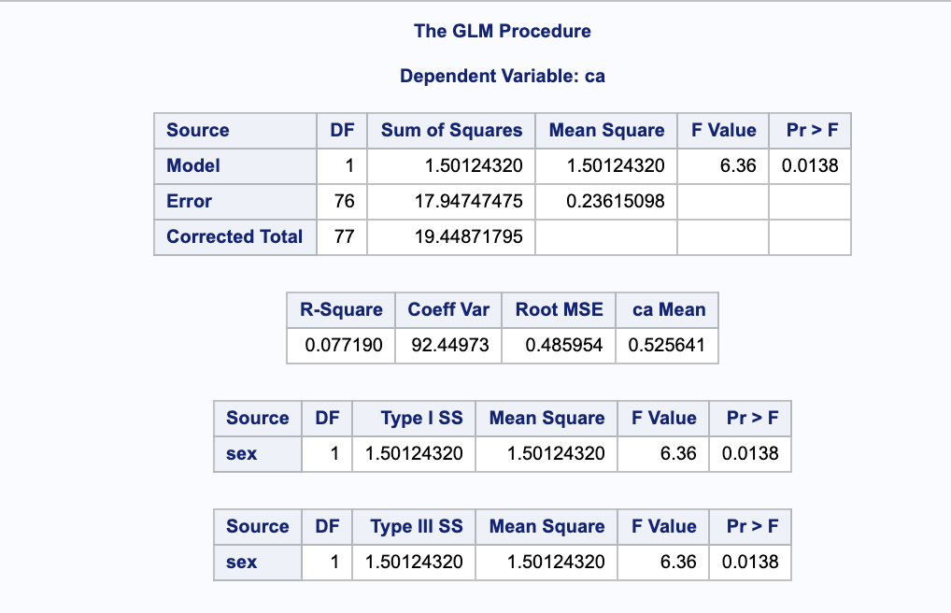
Run a 2x2 analysis with CA and Sex and then run a logistic regression model just using Sex as an explanatory variable
(2x2 ANOVA)
(Logistic Regression)

Slide 8
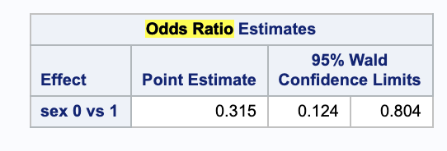
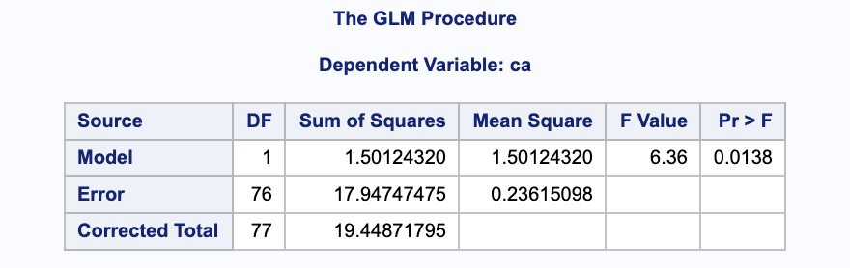
Run a 2x2 analysis with CA and Sex and then run a logistic regression model just using Sex as an explanatory variable
The point estimate of 0.315 (63/200) indicates that females are 1/3 as likely as males to contract the disease.
I had trouble with the odds ratio for the 2x2 Run

